Slide 1
Airline Reservation system
Project Guide
Prof. Sameer Mansuri
Prof. Prachi Pancholi
Prof. Loganathan
Developed By
Khush Patel (15012101031)
Varun Parekh (15012101021)

Slide 2
Overview
Objective
What is ARS ?
How it Works ?
Technology
Features
ER Diagram
Future Scope

Slide 3
Objective
Main objective of this system is to provide Online Registration, Ticket Booking, Online Payment and Searching Facility.

Slide 4
What is ARS ?
ARS stands for Airline Reservation System which is a part of Computer Reservation System (CRS).
It is not just a reservation system but a Global Distribution System which supports travel agencies and other distribution channels alike.
This system provides a facility to ease the tension between agents and real time users.

Slide 5
How ARS works?

Slide 6

How it Works ?

Slide 7
Features
Customers can choose from a large number of Airlines.
Complete details regarding all the Flights.
Easy to Getting details of flights.
User friendly modification so that user can easily interact.
More efficient way to use all the details and your personal details are more secure.

Slide 8
ER Diagram

Slide 9
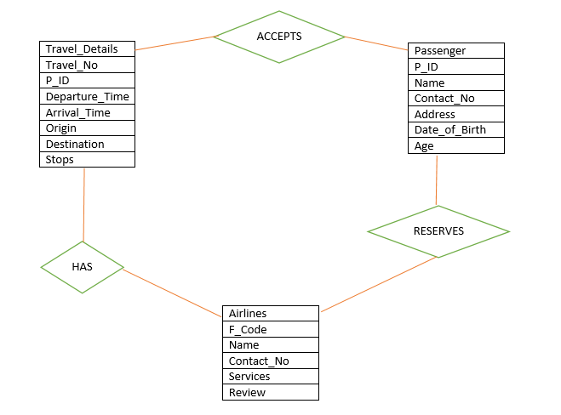
ER Diagram

Slide 10
Future Scope
This application can be used in Smartphones.
Minds to Market Strategy.
Special reservation for Business Class.
Choose able seats for more comfortable journey.
Boarding Facility before 24 Hours.
Pay as per your weight.

Slide 11
Thank You !!!!

